Slide 1
Quantitative Research in Political Science How to apply the classical toolbox
Giuseppe Carteny
UdS SoSe2025 - Intro

Slide 2

Who am I?
Dr. Giuseppe Carteny
I have been a postdoctoral researcher (Wissenschaftlicher Mitarbeiter) at the chair of Prof. Dr. Daniela Braun since 2023
I have been postdoctoral researcher at the Mannheim Centre for European Social Research (MZES) of the University of Mannheim
I research gender-related issues and how far-right is twisting these in UNTWIST project
I obtained my PhD in Political Studies at the University of Milan, and studied political science at the LUISS University of Rome
I use public opinion surveys, experts’ data, party manifestos,… to investigate social and political phenomena in Europe and East Asia

Slide 3
Why this course?
One of the main goals of science is generalisation
Some political science questions aim to make generalisations about populations
If you want to make claims about populations you need tools for investigating them
And you need to know idea about how these tools work!
For instance:
Are democracies less prone to war?
Are young voters more progressive than older ones?
Are far-right actors spreading dis/misinformation more online than other actors?
Is Elon Musk a fascist?

Slide 4
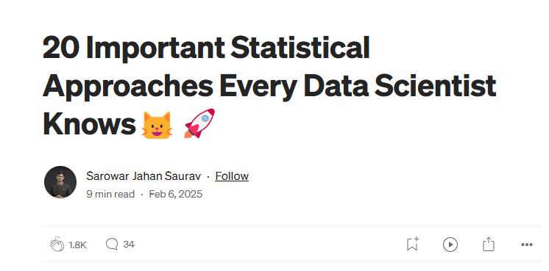
Why this course?
Even if you don’t want to be a research or a scientist, and you want have a normal life, with a well-paid job,… you might still want to learn these skills!
Bayesian Inference Maximum Likelihood Estimation (MLE) Hypothesis Testing (t-test) Analysis of Variance (ANOVA) Principal Component Analysis (PCA) Factor Analysis
Cluster Analysis (K-means) Bootstrapping Time Series Analysis (ARIMA) Time Series Analysis (ARIMA) Multivariate Regression (Multiple Linear Regression) Ridge/Lasso Regression Logistic Regression Mixed Effects Models Nonparametric Tests Monte Carlo Simulation Markov Chain Monte Carlo (MCMC) Robust Regression Copulas Generalized Additive Models (GAMs)

Slide 5
Why this course?
But most importantly what you’ll learn is to
THINKING CLEAR WITH DATA

Slide 6
Structure of the course
Class 1 – Intro: Motivation, materials, aims, requirements,… revising R basics
Class 2 – The first bricks: Data structures, basic statistical concepts, and measures,
Class 3 – Going multivariate! Generalised linear models, and the bread and butter of multivariate methods (i.e., the linear model)
Class 4 – Make your analyses understandable! Quantities of interest and how to visualize them
Class 5 – How to deal with categories and counts: Probit, Logit, & friends
Class 6 – Outro: Review/How to apply these methods to your research questions

Slide 7
Thank you for your attention!

